Slide 1

MENTORNESS MACHINE LEARNING
INTERNSHIP
WORLD CUP 2023 ANALYSIS
Submitted By
Madhurima Rawat
Exploratory Data Analysis(EDA)

Slide 2
INDEX
Introduction
Technology Used
Exploratory Data Analysis (EDA)
Team Performance Analysis
Player Performance Analysis
Opposition and Ground Analysis
Temporal Analysis
Project Resources

Slide 3
Introduction
1. Performing a detailed exploratory data analysis on the World Cup 2023 dataset to uncover patterns.
2. Analyze team-wise performance metrics, including runs scored, wickets taken, and batting/bowling styles, to identify top-performing teams and their strengths.
3. Investigate how teams and players perform against different oppositions and across various playing grounds, identifying specific teams or players excelling in certain conditions, while also studying performance trends over time to reveal any temporal patterns or changes.

Slide 4
Technology Used
Python: A versatile programming language used extensively for data analysis, offering a wide range of libraries and tools.
Matplotlib: A comprehensive plotting library in Python used for creating static, interactive, and publication-quality visualizations.
Seaborn: A statistical data visualization library built on top of Matplotlib, providing a high-level interface for creating informative and attractive plots.
GitHub: A leading platform for version control and collaborative development, enabling users to share, manage, and contribute to code repositories for projects of all scales.

Slide 5
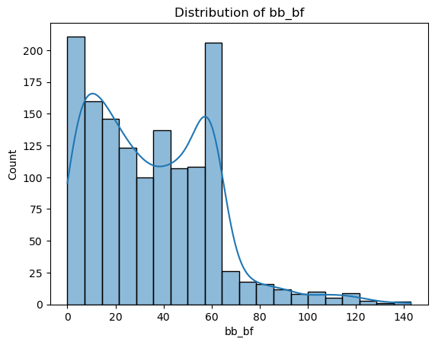
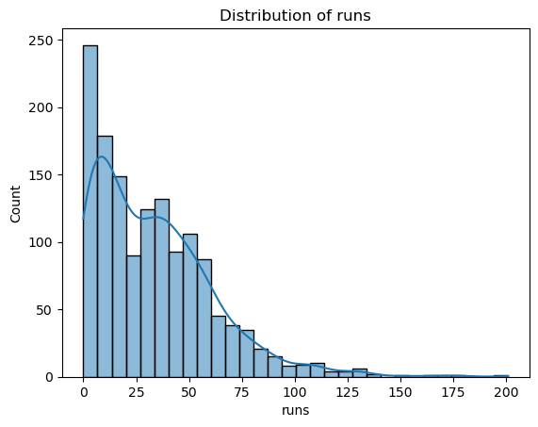
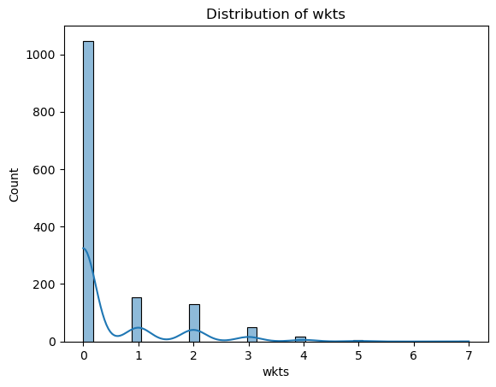
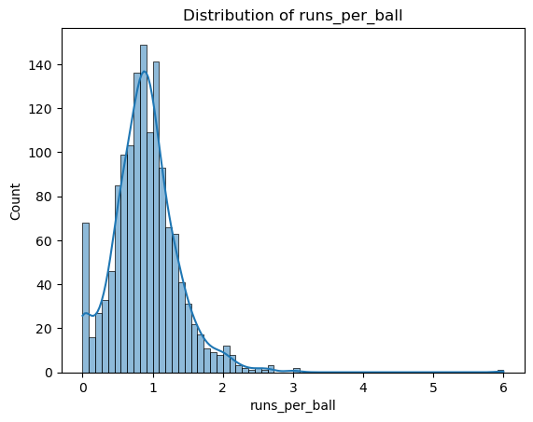
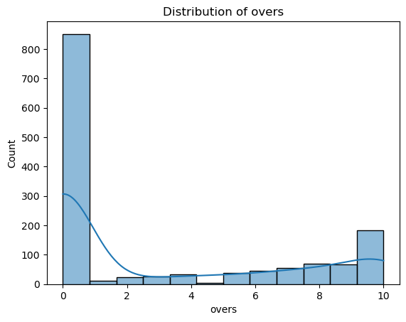
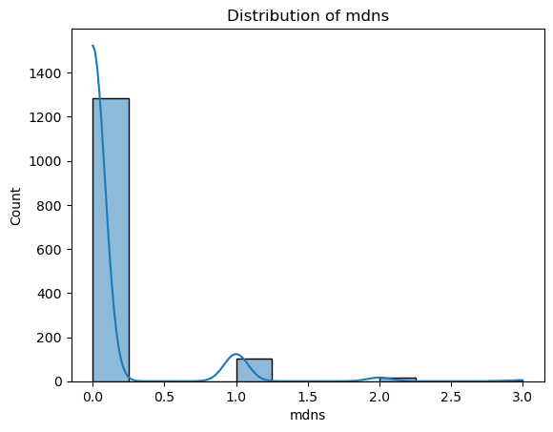
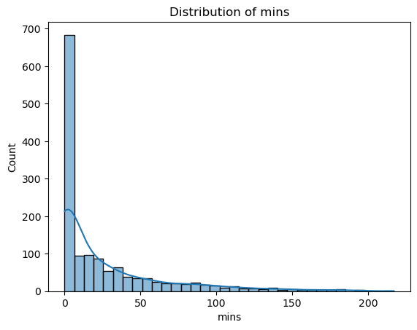
Exploratory Data Analysis (EDA)
World Cup 2023 Data Analysis

Slide 6
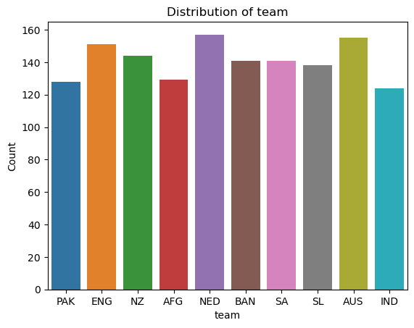
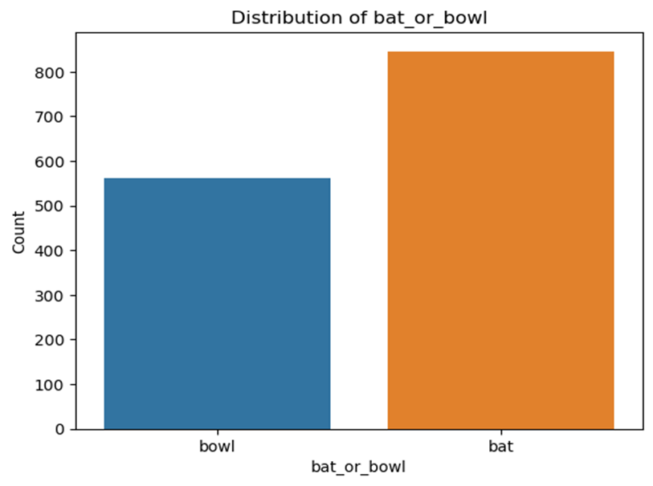
Cont.

Slide 7
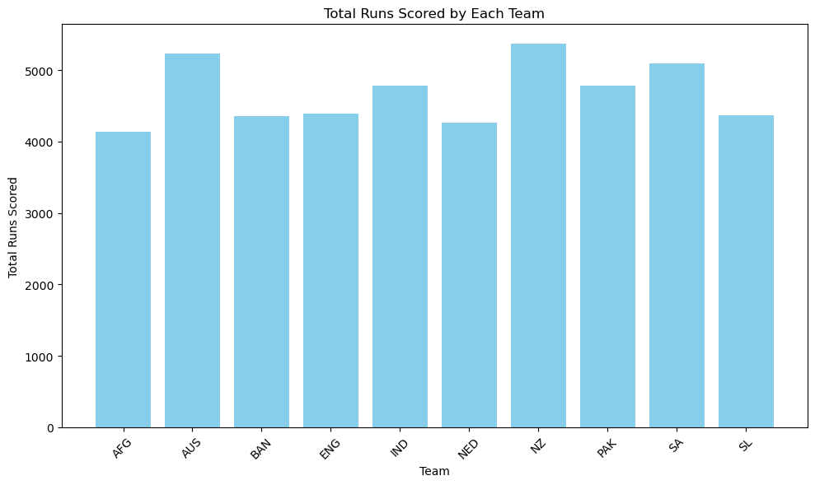
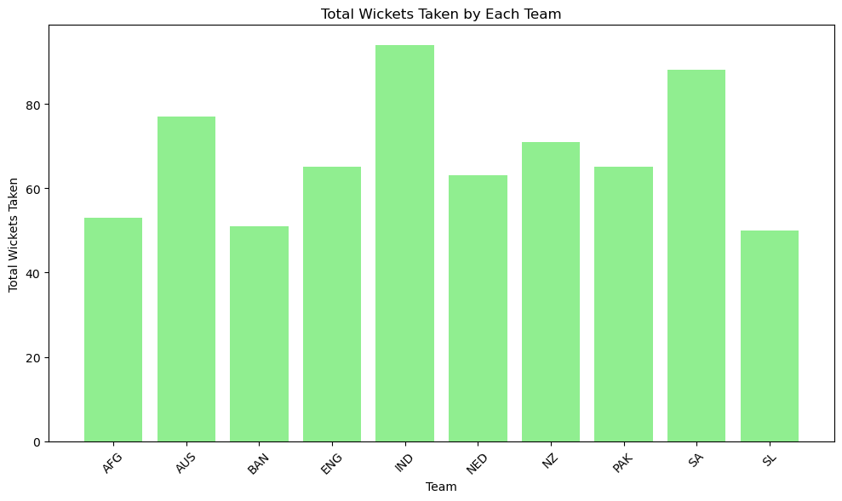
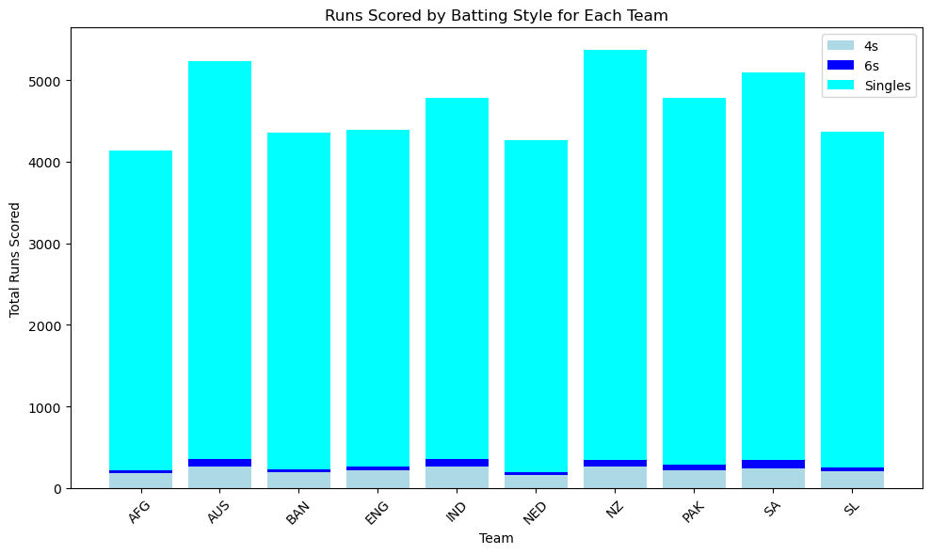
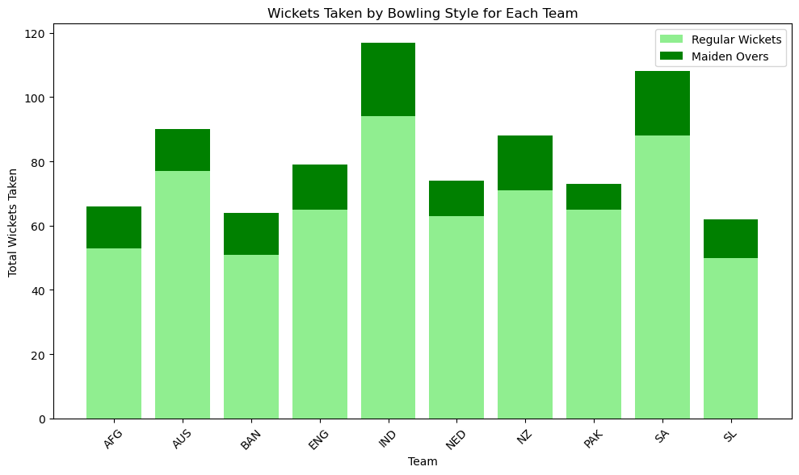
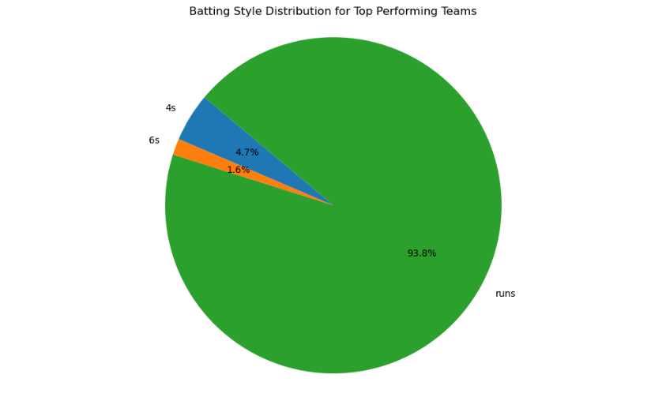
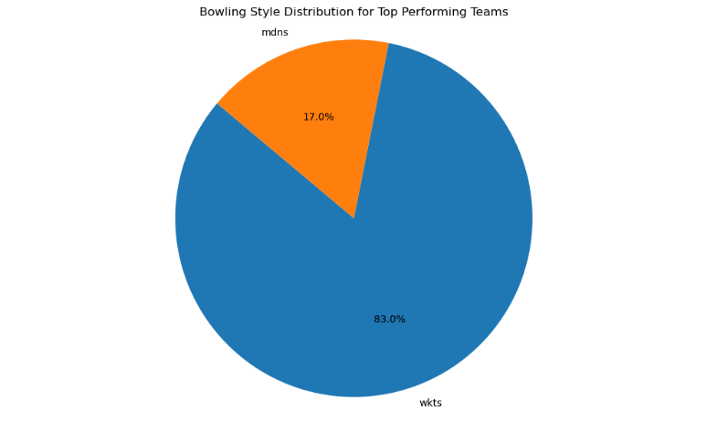
1. Team Performance Analysis
World Cup 2023 Data Analysis

Slide 8
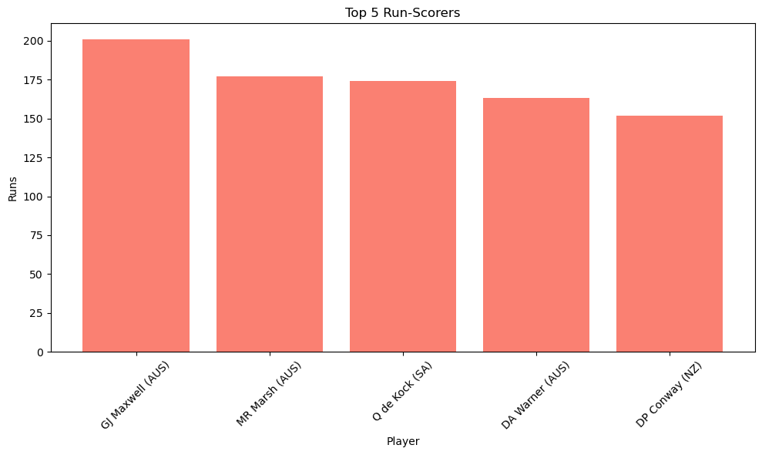
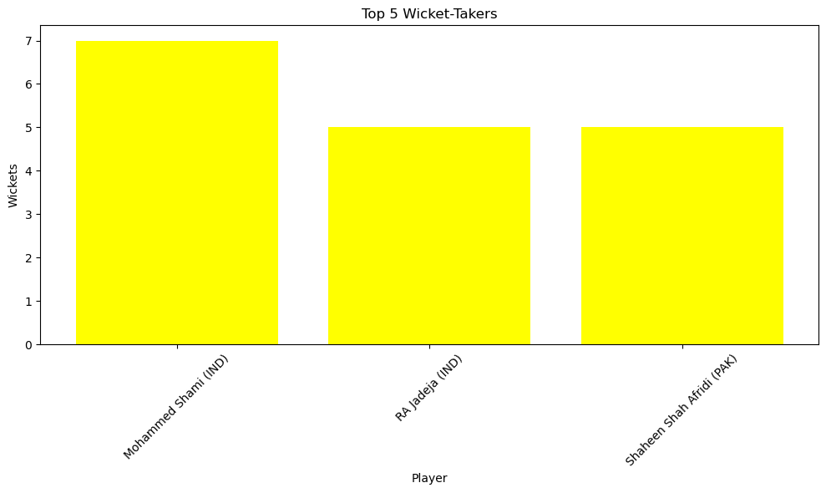
2. Player Performance Analysis

Slide 9
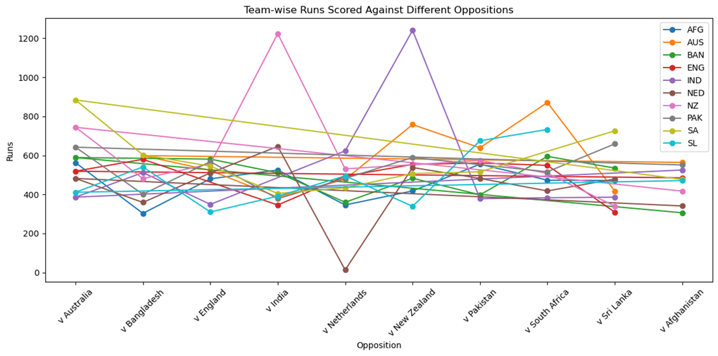
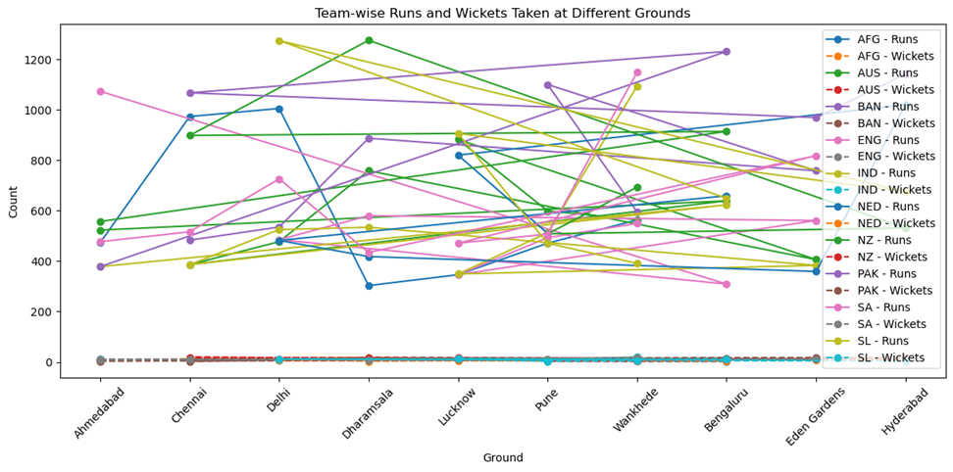
3. Opposition and Ground Analysis

Slide 10
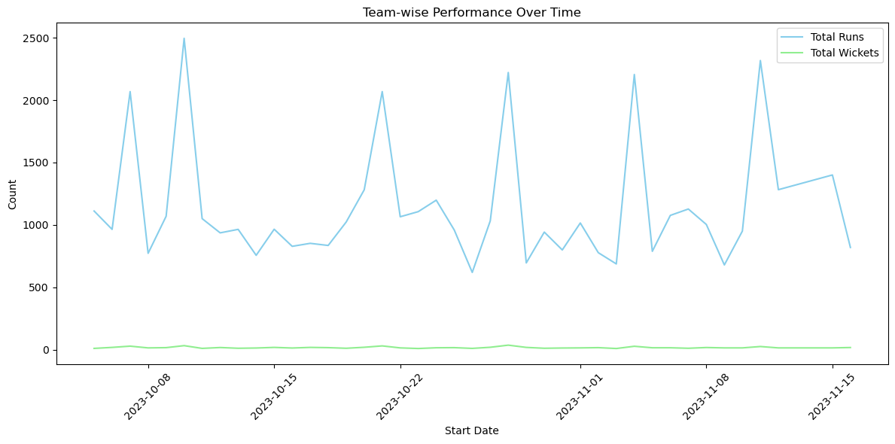
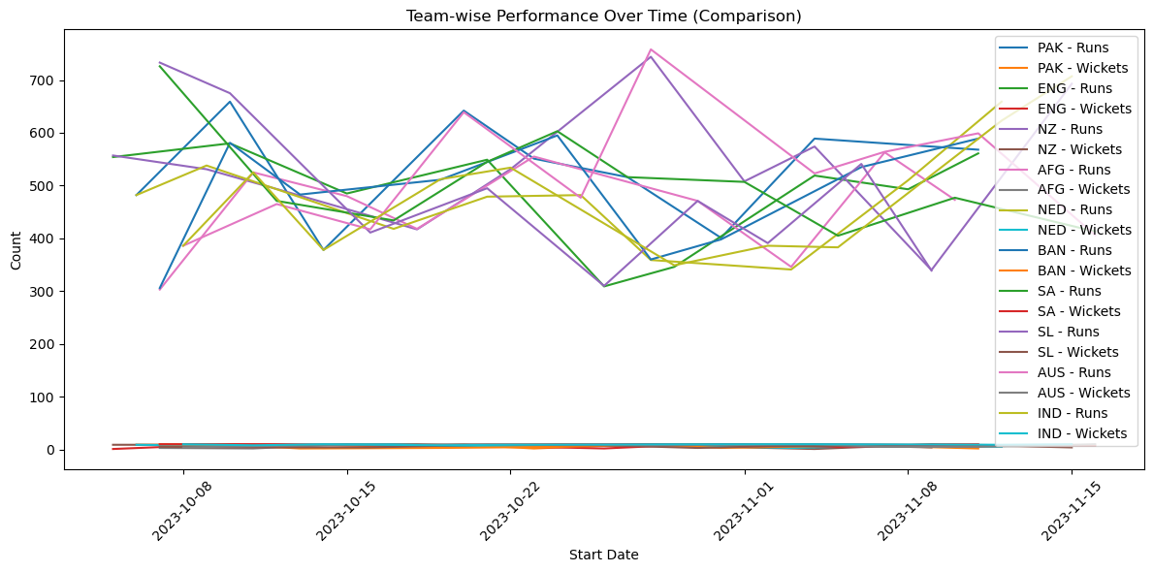
4. Temporal Analysis

Slide 11
Project Resources
Cricket Illustration: Cricket Illustration:
GitHub Repository:
Codes related to this project can be seen at my GitHub Repository:
GitHub Repository Link: https://github.com/madhurimarawat/World-Cup-2023-Data-Analysis

Slide 12
THANK YOU FOR LISTENING TO MY PRESENTATION
Any questions?

